Slide 1
CS 772/872: Advanced
Computer and Network Security
Fall 2025
Course Link:
https://shhaos.github.io/courses/CS872/netsec-fall25.html
Instructor: Shuai Hao
shao@odu.edu
www.cs.odu.edu/~haos

Slide 2
Instructor – Shuai Hao
Ph.D., 2017 -- College of William and Mary, Williamsburg, VA
Postdoc, 2018 – 2019 – CAIDA, UC San Diego, La Jolla, CA
Research
Applying measurement, empirical study, and data-driven approach to (1) understand Internet underlying Infrastructure and (2) to develop enhancement to improve Internet performance, robustness, and security
Internet Topology
Internet Routing System
Domain Name System
Content Delivery Networks
Web Security and Privacy
Online Fraud
Underground E-Commerce
Cybercrime

Slide 3
What this course is …
What this course is NOT …
Graduate-level course
Study classical and latest relevant research problems
Reading Research Papers
Reviewing/ Presenting papers
Writing Report
Listening-and-learning
Textbook knowledge
Knowledge-based Exam
Fundamental Background will be introduced

Slide 4
Why CS 772/872?
Credits / Requirements
Advanced Topics
Sitting on the frontier of popular research area

Slide 5
Why CS 772/872?
Credits / Requirements
Advanced Topics
Sitting on the frontier of popular research area
Computer and Network Security
Classical & Emerging Research area
Fundamental & practical problems that are related to most areas of development

Slide 6
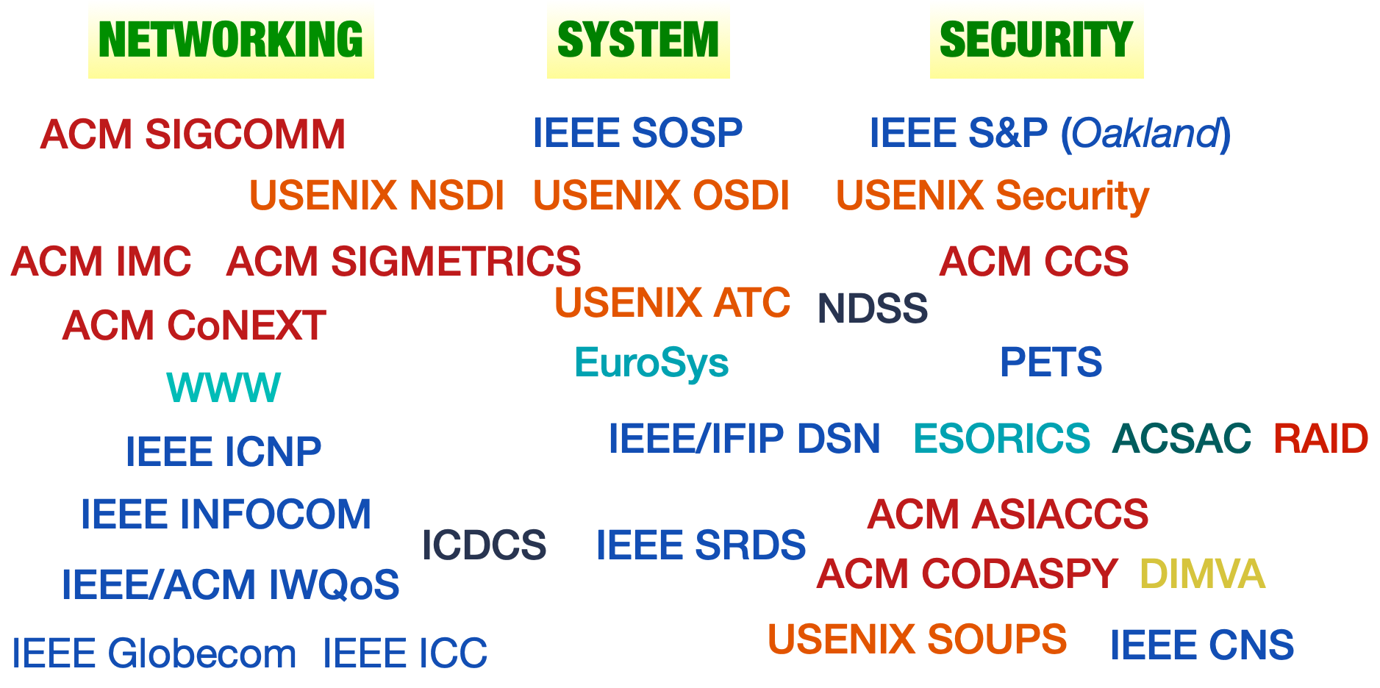
Resources
Premier Conferences in Networking & Security

Slide 7
Course Workloads
Course Presentations
Teach us
Paper Reviews
Gain Insights & practice your duty
Final Report
Write a paper/survey

Slide 8
Paper Review
Summarize the main idea
Problem they solved
Approach they took (what’s the novelty)
How did they evaluate
Pros & Cons: Which parts you like & don’t like
Methodology? Reasonable Experiment design? Solid results?
Any ways to improve the work

Slide 9
Paper Review
Summarize the main idea
Problem they solved
Approach they took (what’s the novelty)
How did they evaluate
Pros & Cons: Which parts you like & don’t like
Methodology? Reasonable Experiment design? Solid results?
Any ways to improve the work
Real public conference reviews
ACM IMC 2011 - 2013
Sample1, Sample2

Slide 10
Presentation
Basic Presentation Structure
Motivation of the work
Technical background
Proposed approaches/Major contribution
Evaluation results/discussion
Conclusion and Extension
You could do more
History/evolution of relevant techniques
Comparison/complementary study
Following work

Slide 11
Presentation
Colloquium-style Presentations
~60 mins + discussion
Using your own slides
Including course information, original authors, and the presenter in your title page
Need to see more well-presented seminar talks?
Stanford NetSeminar
https://www.youtube.com/channel/UCDjWhwewESyX335Rp6B1PEw
Cornell-Princeton Center for Network Programming
https://www.youtube.com/channel/UCCPScZgIFYxuuqj8IsPpgeQ

Slide 12
Final Report
A formal technical paper
Using formal IEEE or ACM conference template
Writing with Latex!
Progress
Define your topic: problem statement
Paper structure
Preliminary results
Final report
A final presentation of your report at last lecture (~5 min)
First Due (10/11)
Final Due

Slide 13
Final Report
Do a research
Analysis / Assessment
Measurement
Prototyping
Optional: Pursue a joint project with other course
Getting approval from the other instructor
Schedule a joint meeting with both instructors to present your idea

Slide 14
Final Report
Examples of projects
UC Berkeley CS 261N: Internet/Network Security
http://www.icir.org/vern/cs261n/project.html
MIT 6.875: Computer and Network Security
http://courses.csail.mit.edu/6.857/2016/projects

Slide 15
Final Report
Survey Paper
Comprehensive and thoughtful literature survey of a particular topic
Touching the State-of-the-art
Connecting to your potential research interests
Sample1, Sample2

Slide 16
Final Report
Survey Paper
Comprehensive and thoughtful literature survey of a particular topic
Touching the State-of-the-art
Connecting to your potential research interests
Systematization of Knowledge (SoK)
Introduced by IEEE Security and Privacy since 2010
Collection of SoK papers from IEEE Security and Privacy
https://oaklandsok.github.io/

Slide 17
CS 772/872: Advanced
Computer and Network Security
Fall 2022
Course Link:
https://shhaos.github.io/courses/CS872/netsec-fall2022.html

